Slide 1
Responsive
Responsive web design makes your web page look good on all devices.
-Media Queries
-Grid Layout
-

Slide 2
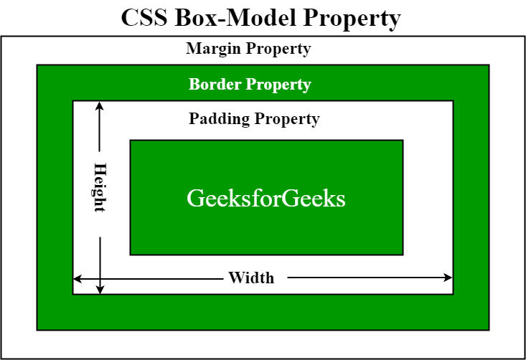
Box model The CSS box model is essentially a box that wraps around every HTML element. It consists of: margins, borders, padding, and the actual content.

Slide 3
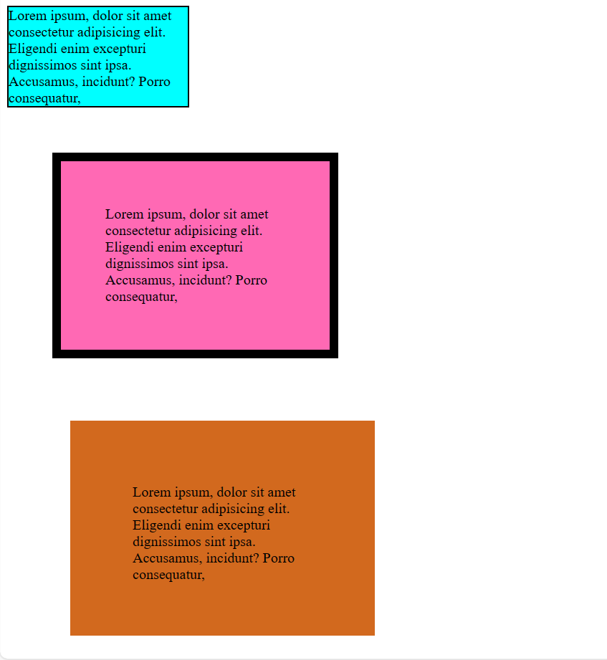
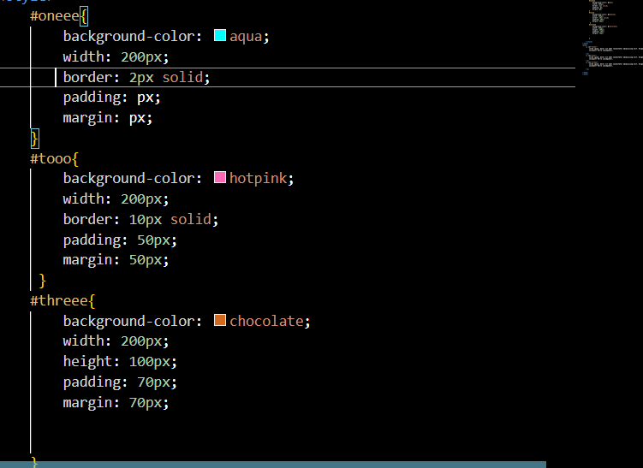
Content - The content of the box, where text and images appear Padding - Clears an area around the content. The padding is transparent Border - A border that goes around the padding and content Margin - Clears an area outside the border. The margin is transparent

